Slide 1
Title:
Designing a adaptive traffic control system using esp32

Slide 2
Problem Statement:
Urban intersections are plagued by traffic congestion, inefficient signal timings, and increasing vehicular density, leading to unnecessary waiting, fuel wastage, and air pollution. Conventional traffic lights operate on fixed cycles regardless of real-time conditions, causing inefficiency and driver frustration. The need exists for an intelligent traffic signal solution that can dynamically adapt to live traffic patterns and reduce congestion through optimal signal phase allocation.

Slide 3
Objectives:
Develop an adaptive traffic light control system using ESP32 to dynamically adjust signal timing based on real-time traffic density.
Integrate ultrasonic sensors to detect vehicle presence at each lane or signal.
Ensure the system is cost-effective, scalable, and suitable for urban implementation.
Allow future expansion for emergency vehicle prioritization and advanced analytics.

Slide 4
Use cases:
Urban Intersection Management: Adaptive control in busy city junctions to minimize wait times and clear congestion.
Emergency Response: (Future scope) Priority passage for ambulances or fire trucks by dynamically switching lights.
Low-Traffic Scenarios: Signals automatically skip directions without waiting vehicles for improved flow.

Slide 5
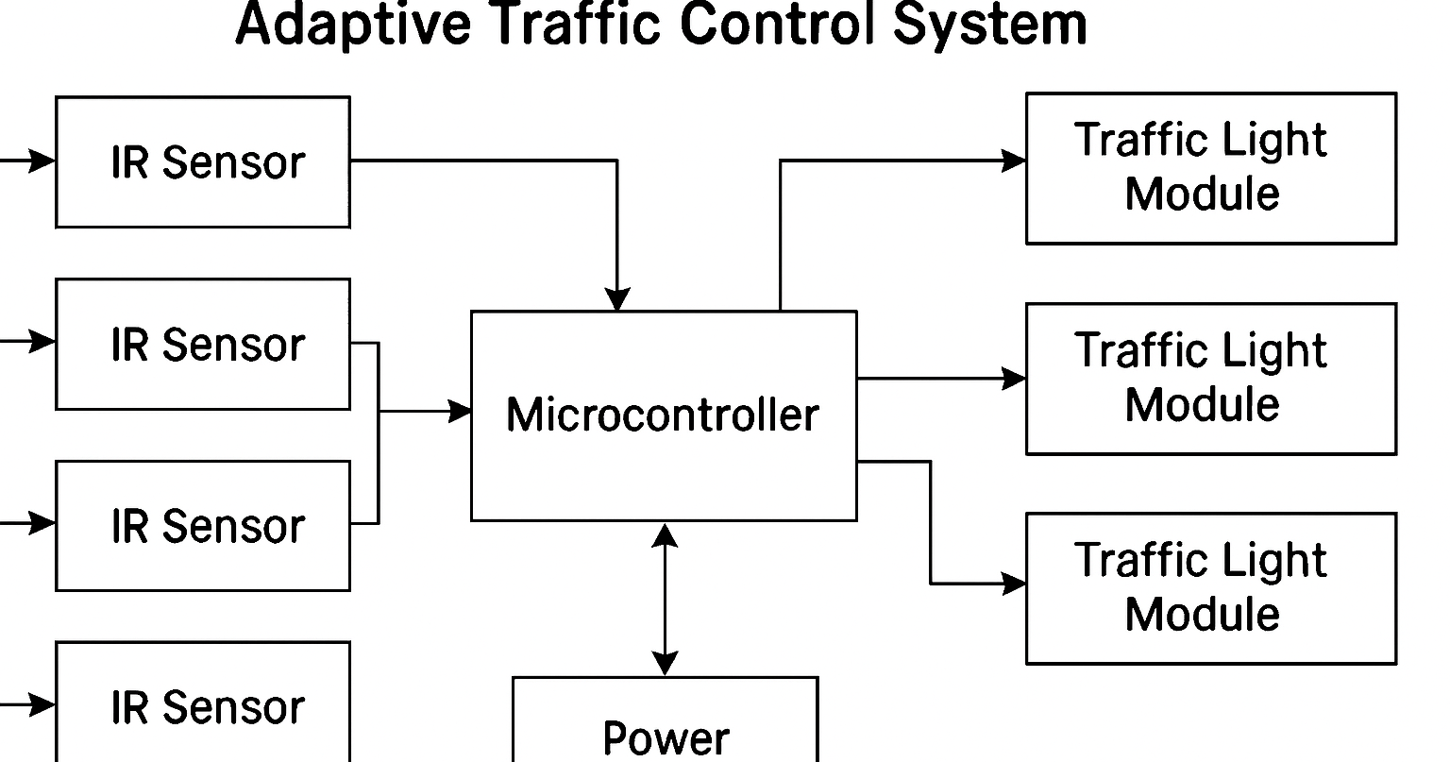

Slide 6
Hard ware & Software used:
ESP32 WiFi microcontroller
Ultrasonic Sensors & IR sensor
LEDs (Red, Yellow, Green for each road)
Resistors (220-ohm, 12x)
Breadboard & connecting wires
5V Power Supply
Micro-USB cable (for ESP32)
Arduino IDE

Slide 7
Application:
Smart Cities: Integrate into intelligent urban mobility platforms for real-time traffic adaptation.
Traffic Analytics: Data can support urban planning or dynamic control strategy improvements.
Public Safety: (Future) Emergency evacuation management and priority signaling.

